Slide 1

Predicting Motor Vehicle Accident Severity with Classification Models
Melissa Mullen
MET CS 777
10/15/2024
Final Project

Slide 2
Introduction
Objective: Analyze motor vehicle accident data to predict the severity of accidents (non-severe vs. severe) based on weather-related conditions.
Dataset: US Accidents (2016-2023)
46 columns and 7,728,394 rows
Contains columns relevant to accident severity, weather conditions, road structures, time of day, etc.
Available as CSV download from Kaggle
Sampled dataset used for project contains 10,000 rows
Goal: Create a classification model with at least 70% accuracy that produces less false negatives than false positives.

Slide 3
Data Dictionary
 | Column Name | Data Type | Description
1 | ID | String | A unique identifier of the accident record.
2 | Source | String | Source of the raw accident data
3 | Severity | Decimal | The severity of the accident, ranging from 1 (least impact on traffic) to 4 (significant impact on traffic).
4 | Start_Time | Date | Start time of the accident (in local time zone)
5 | End_Time | Date | End time of the accident (in local time zone). Indicative of when the impact on traffic has resolved.
6 | Start_Lat | Decimal | Latitude in GPS coordinates of accident starting point.
7 | Start_Lng | Decimal | Longitude in GPS coordinates of accident starting point.
8 | End_Lat | Decimal | Latitude in GPS coordinates of accident ending point.
9 | End_Lng | Decimal | Longitude in GPS coordinates of accident ending point.
10 | Distance(mi) | Decimal | Length of road (in miles) affected by the accident.
11 | Description | String | Description of the accident (reported by human source).
12 | Street | String | Street name of address of accident.
13 | City | String | City of address of accident.
14 | County | String | County of address of accident.
15 | State | String | State of address of accident.
16 | Zipcode | String | Zip code of address of accident.
17 | Country | String | Country of address of accident.
18 | Timezone | String | Time zone of accident.
19 | Airport_Code | String | An airport-based weather station that is closest to the accident.
20 | Weather_Timestamp | Date | A timestamp of the weather observed during the accident (in local time).
21 | Temperature(F) | Decimal | Temperature at time of accident (in Fahrenheit).
22 | Wind_Chill(F) | Decimal | Wind chill at time of accident (in Fahrenheit).
23 | Humidity(%) | Decimal | Humidity at time of accident (in percentage).
24 | Pressure(in) | Decimal | Air pressure at time of accident (in inches).
25 | Visibility(mi) | Decimal | Visibility at time of accident (in miles).
26 | Wind_Direction | String | Wind direction at time of accident.
27 | Wind_Speed(mph) | Decimal | Wind speed at time of accident (in miles per hour).
28 | Precipitation(in) | Decimal | Precipitation (in inches) at time of accident (if any).
29 | Weather_Condition | String | Weather conditions at time of accident (rain, snow, thunderstorm, fog, etc.).
30 | Amenity | Boolean | Presence of amenity near the accident.
31 | Bump | Boolean | Presence of speed bump near the accident.
32 | Crossing | Boolean | Presence of a cross walk near the accident.
33 | Give_Way | Boolean | Presence of a give_way near the accident.
34 | Junction | Boolean | Presence of a junction near the accident.
35 | No_Exit | Boolean | Presence of a no_exit near the accident.
36 | Railway | Boolean | Presence of a railway near the accident.
37 | Roundabout | Boolean | Presence of a roundabout near the accident.
38 | Station | Boolean | Presence of a station near the accident.
39 | Stop | Boolean | Presence of a stop near the accident.
40 | Traffic_Calming | Boolean | Presence of traffic_calming near the accident.
41 | Traffic_Signal | Boolean | Presence of a traffic signal near the accident.
42 | Turning_Loop | Boolean | Presence of a turning_loop near the accident.
43 | Sunrise_Sunset | String | Period of day (day or night) based on sunrise/sunset at time of accident.
44 | Civil_Twilight | String | Period of day (day or night) based on civil twilight at time of accident.
45 | Nautical_Twilight | String | Period of day (day or night) based on nautical twilight at time of accident.
46 | Astronomical_Twilight | String | Period of day (day or night) based on astronomical twilight at time of accident.

Slide 4

Data Preparation – Data Sampling
The data used in this project was a 10,000-row sample derived from the 500,000-row sampled dataset available on Kaggle
Had to be small enough to run on local machine
Required some preparation:
Removed rows containing any missing data
Data was imbalanced, required oversampling to ensure severity data was equally distributed
Oversampled minority class (severe accidents) as there were significantly more non-severe accidents
5,049 non-severe accidents, and 4,951 severe accidents

Slide 5
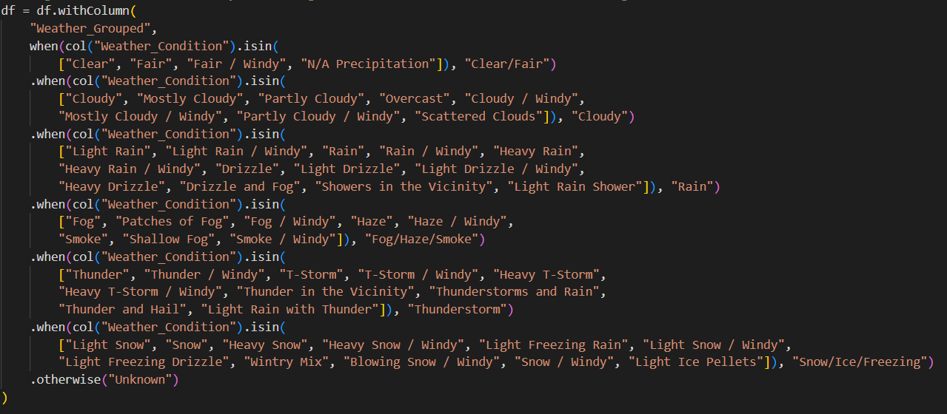
Data Preparation – Data Preprocessing
Transformed Severity into a binary target variable (non-severe: 0, severe: 1)
Severity 1 and 2 became non-severe
Severity 3 and 4 became severe
Organized Weather_Condition into grouped categories
Clear/Fair, Cloudy, Rain, Fog/Haze/Smoke, Thunderstorm, Snow/Ice/Freezing, and Unknown
Calculated accident duration
Renamed columns as needed

Slide 6
Data Preparation – Feature Engineering
Encoded categorical variables (Weather_Condition) using StringIndexer() and OneHotEncoder ()
Standardized numerical features using StandardScaler()

Slide 7

Definitions
StringIndexer(): A tool used for feature transformation, encodes categorical string columns into unique numerical values.
OneHotEncoder(): A tool used for feature transformation, converts the numerical values into unique binary vectors.
StandardScaler(): A tool used for data normalization, standardizes values by scaling them to have a consistent range where the average value is zero.
Logistic Regression: A linear machine learning algorithm used for predicting the probability of an outcome of an event, typically used for prediction and classification.
Support Vector Machine (SVM): A machine learning algorithm used for classifying data, works by locating the optimal hyperplane for separating data into different classes.
Random Forest: A machine learning algorithm used for classifying data, works by combining several decision trees and reaching one singular outcome.
Accuracy: Measures the number of correct predictions.
Precision: Measures how many positive predictions were correct.
Recall: Measures how many actual positive cases were correctly identified.
F1 score: A balance of precision and recall values.

Slide 8
Model results
Logistic Regression:
Accuracy: 55.93%
Precision: 0.5163
Recall: 0.5734
F1 Score: 0.5433
Support Vector Machine (SVM):
Accuracy: 54.64%
Precision: 0.5762
Recall: 0.551
F1 Score: 0.5633
Confusion Matrix
TN: 576 | FP: 476
FN: 378 | TP: 508
Confusion Matrix
TN: 492 | FP: 417
FN: 462 | TP: 567
Random Forest:
Accuracy: 61.61%
Precision: 0.6514
Recall: 0.6152
F1 Score: 0.6328
Random Forest (Cross-Validation):
Accuracy: 68.27%
Precision: 0.6941
Recall: 0.6851
F1 Score: 0.6896
Confusion Matrix
TN: 553 | FP: 343
FN: 401 | TP: 641
Confusion Matrix
TN: 640 | FP: 301
FN: 314 | TP: 683

Slide 9
Model results (Duration_Minutes)
Logistic Regression:
Accuracy: 55.88%
Precision: 0.5112
Recall: 0.5735
F1 Score: 0.5406
Support Vector Machine (SVM):
Accuracy: 54.95%
Precision: 0.5732
Recall: 0.5546
F1 Score: 0.5637
Confusion Matrix
TN: 580 | FP: 481
FN: 374 | TP: 503
Confusion Matrix
TN: 501 | FP: 420
FN: 453 | TP: 564
Random Forest:
Accuracy: 70.12%
Precision: 0.5518
Recall: 0.7974
F1 Score: 0.6523
Random Forest (Cross-Validation):
Accuracy: 78.17%
Precision: 0.7602
Recall: 0.800
F1 Score: 0.7796
Confusion Matrix
TN: 816 | FP: 441
FN: 138 | TP: 543
Confusion Matrix
TN: 767 | FP: 236
FN: 187 | TP: 748

Slide 10
Discussion
Unable to reach goal accuracy of at least 70% with just weather-related features
Severity is gauged by impact on traffic
While severe weather is associated with motor vehicle accidents, it may not be strongly associated with traffic impact
For example, there are typically less drivers on the road during severe weather
Beneficial features would’ve included speed limit, driver impairment, and number of vehicles involved in the accident
Please note: adding columns relevant to road structures did not change model accuracy
Random Forest with Cross Validation produced an accuracy of 78.17% with Duration_Minutes
Also produces more false positives than false negatives, as hoped

Slide 11
Conclusion
Objective: Analyze motor vehicle accident data to predict the severity of accidents (non-severe vs. severe) based on weather-related conditions
Outcome: Able to apply machine learning algorithms using PySpark to predict accident severity from weather-related conditions using the US Accidents (2016-2023) dataset.
Goal: Create a classification model with at least 70% accuracy that produces less false negatives than false positives.
Results:
Unable to reach goal accuracy with just weather-related conditions, but able to reach goal accuracy with accident duration included
Best performing model (Random Forest with Cross-Validation) produced less false negatives than false positives
Random Forest models typically manage complex relationships between features and non-linear patterns in data better than Logistic Regression or SVM models
Implications: By identifying high-risk weather conditions, emergency personnel could best prepare for accident response by having an appropriate number of staff and resources available before inclement weather.

Slide 12

Questions?
Please feel free to contact me! MDMullen@bu.edu

